Slide 1
Transfer Learning for the Recognition of Wildlife Camera Trap Imagery
COSC591 Presentation (2019)
Andrew J. Flighty

Slide 2
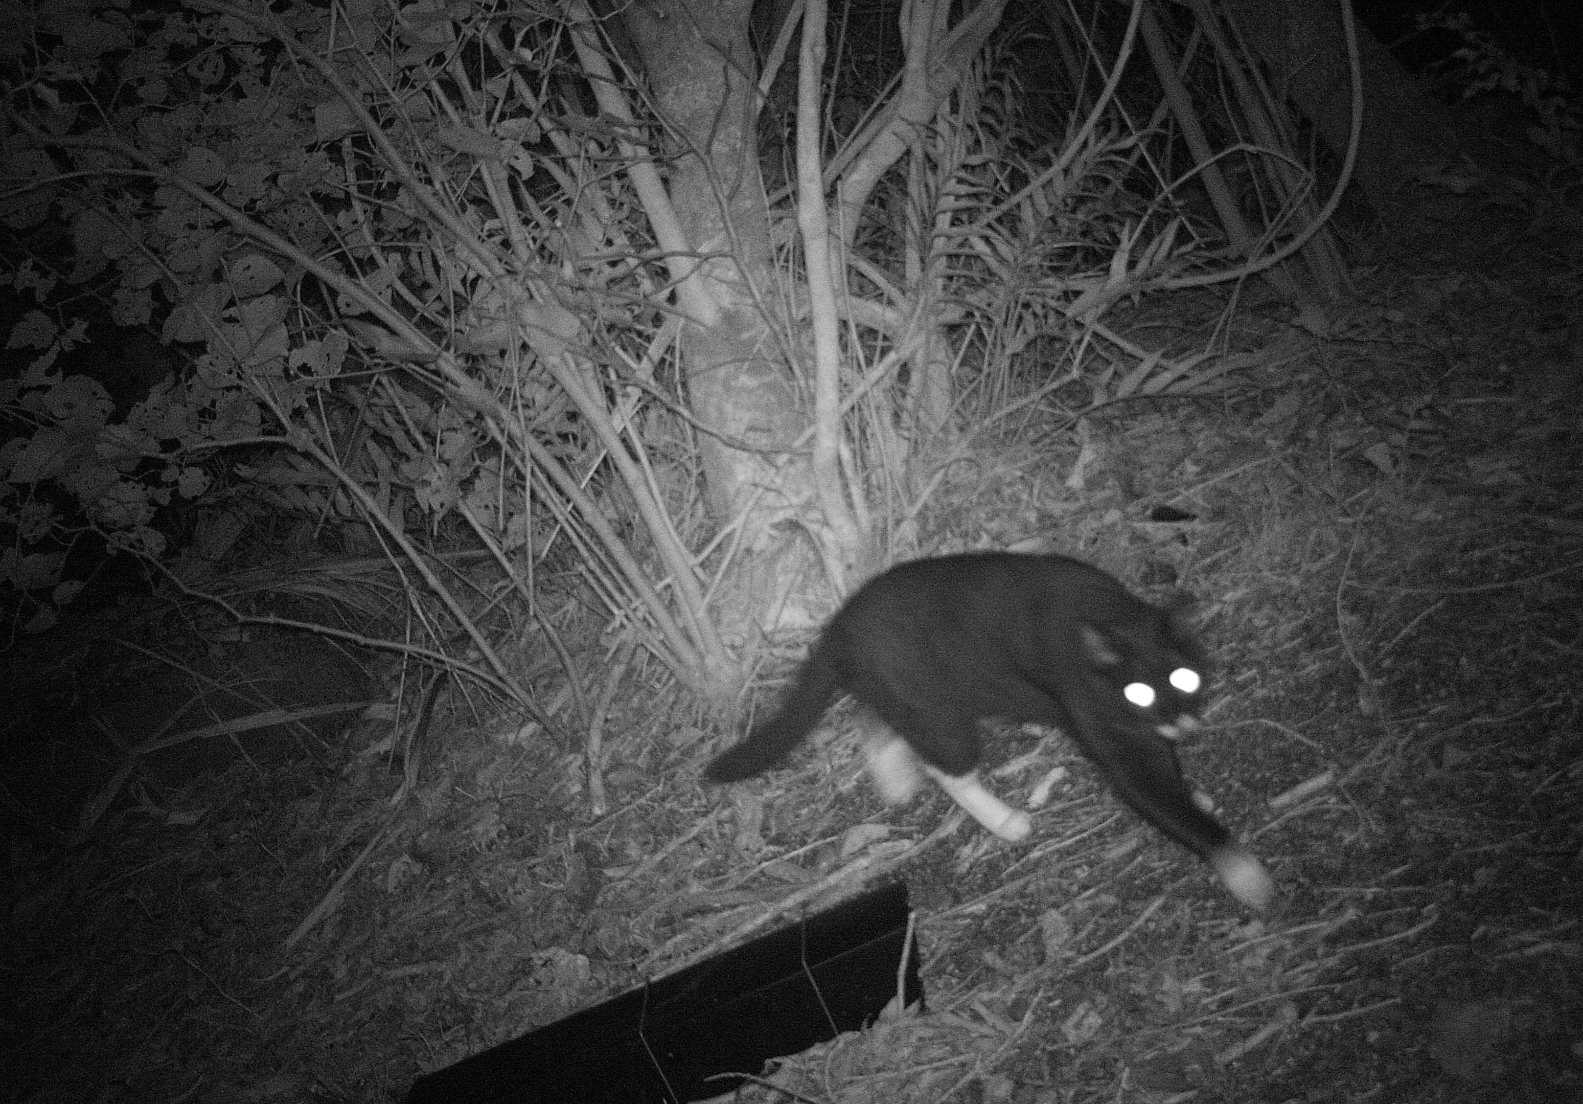
Project background
Key stakeholders: Manaaki Whenua Landcare Research (MWLR), GroundTruth, World Wildlife Fund NZ, New Zealand Government
MWLR seeking to build a machine learning equipped web service capable of classifying wildlife camera trap imagery
Gathered information to be easily accessed and shared between authorised users to guide future conservation efforts

Slide 3
Project aims
Few models exist to recognise camera trap imagery.
Fewer still have been built to integrate with client-side web applications
Aim: comprehensively investigate, evaluate, and report on deep learning-based models for the recognition of New Zealand camera trap species. Specifically, examined the effectiveness of transfer learning
Findings to shed light on feasibility of the models in terms of 1) classification accuracy; and 2) integration with web application

Slide 4
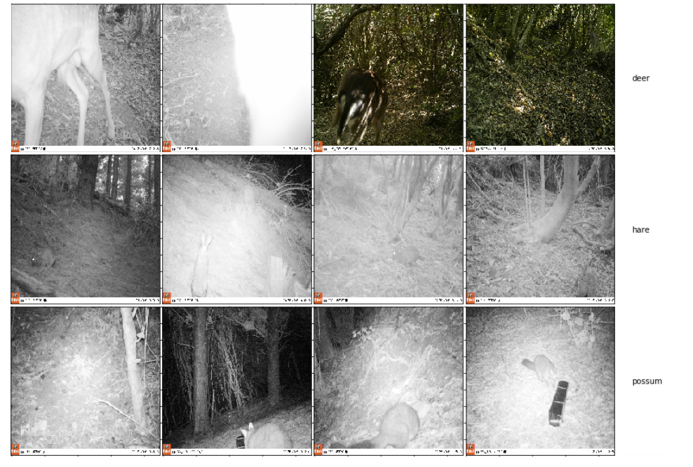

Slide 5
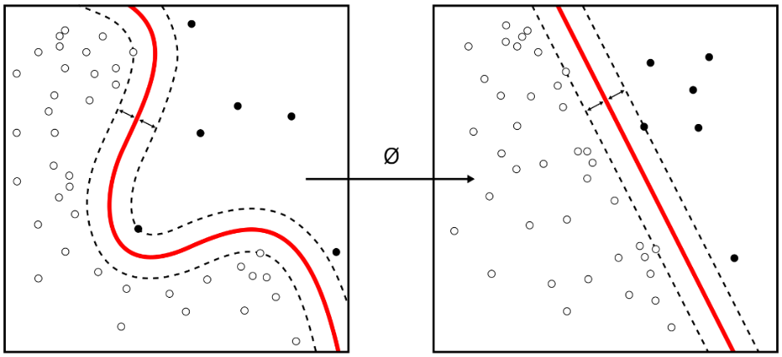
Project plan
1. Data acquisition and pre-processing
Wellington camera trap dataset (176 GB)
2. Model exploration
MobileNet as a baseline
Hyperparameter adjustments
3. Model fine-tuning
Models benchmarked on overall accuracy, precision, recall, and F1 scores
4. Model deployment and integration
Tensorflow.js for web application

Slide 6
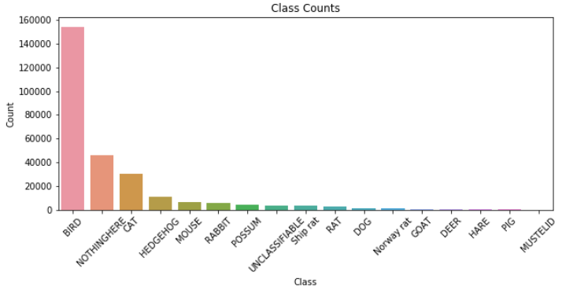

Slide 7
Project results
76 models were trained over a 7-week period from 10th August to 2nd of October.
A range of parameters/hyperparameter settings were investigated:
Number of unfrozen model layers
Optimizer (Adam, Stochastic Gradient Descent, RMSProp, and Adadelta)
Learning rate
Image augmentation strategies (rotations, zooms, sheers, and horizontal flips)
Weight decay
Batch size
Number of epochs

Slide 8
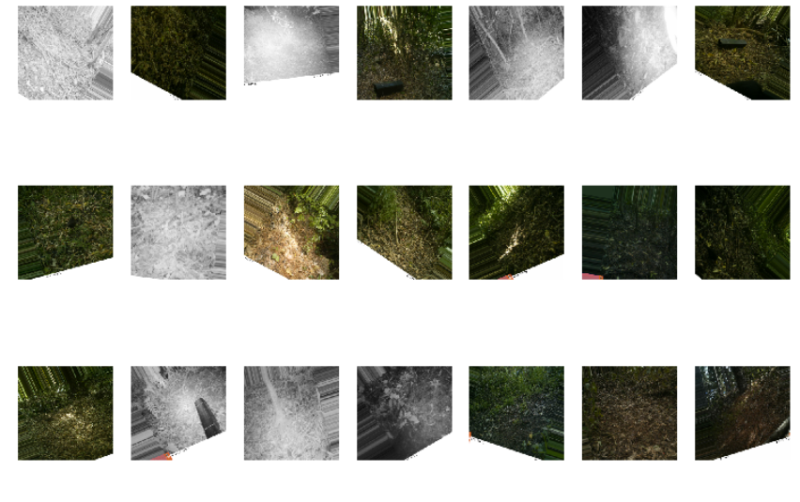

Slide 9
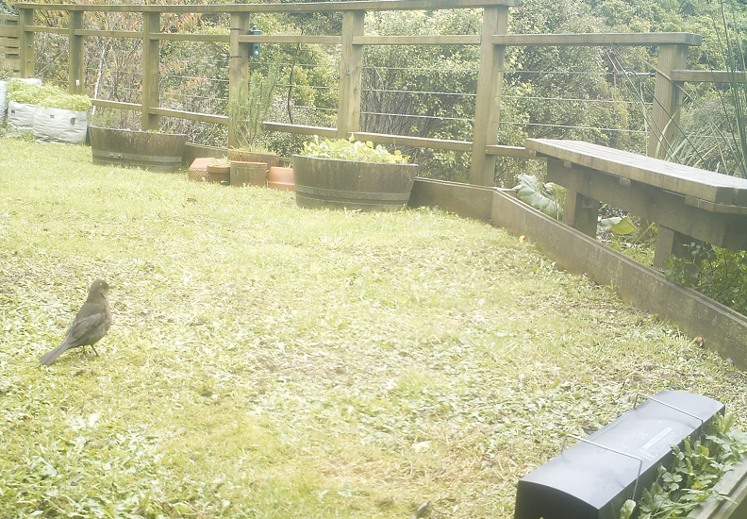
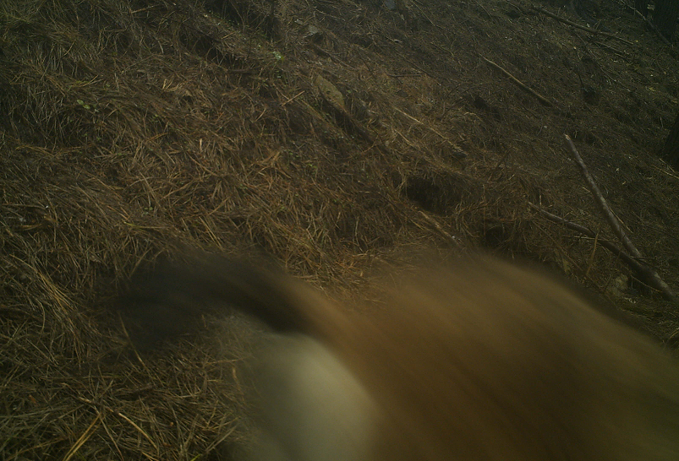


Project results
Retaining “good” quality images significantly improved per-class classification accuracy

Slide 10
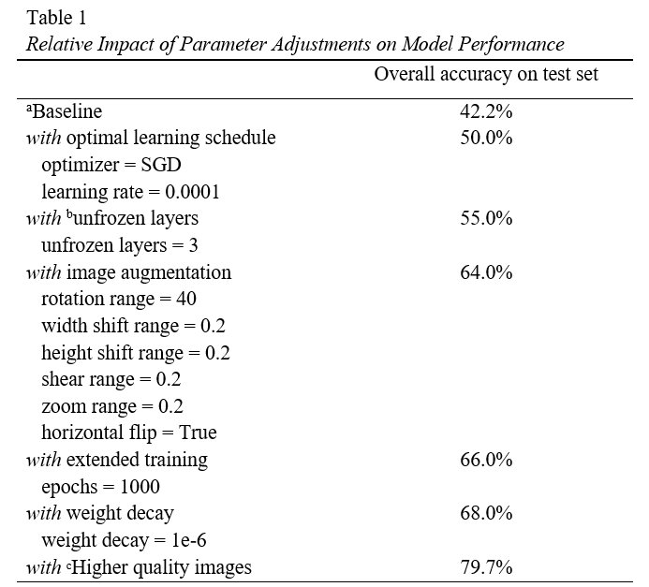

Slide 11
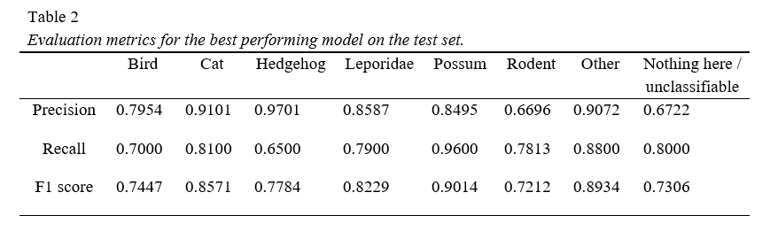

Slide 12
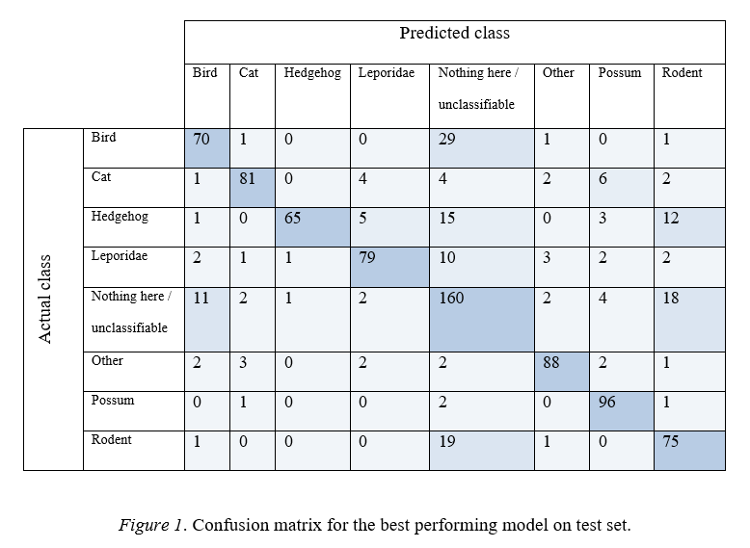

Slide 13
Project summary
Benefit 1: Wildlife camera trap imagery was predicted with a modest degree of accuracy (79.7% accuracy on test set)
Benefit 2: Due to its small file size (24.8MB), the model was easily deployed and integrated into an in-browser machine learning web application.
Limitation: The non-animal class (nothing here / unclassifiable) arose as the main source of misclassification.

Slide 14
Conclusion & future directions
Overall, findings provide a ‘proof-of-concept’ that transfer learning can be successfully used to recognize wildlife camera trap imagery.
Future research directions:
Manual review of good image quality in subsequent investigations
Potential for two-stage classifier (animal present/absent -> animal identity)
Larger datasets for finer-scale class recognition

